Slide 1
BCT 2310: Automata theory
Lecturer: Mrs. Martha Gichuki
Email ID: mgichuki@jkuat.ac.ke

Slide 2
Push Down Automata
Extensions of Finite Automata
The family of languages accepted by the DFA and NFA is called the family of regular languages.
More powerful automata can accept more complicated languages.
Such automata include: -

Slide 3
1. Pushdown Automata (PDA)
Such machines are identical to DFAs (or NFAs), except that they additionally carry memory in form of a stack.
The transition function will now also depend on the symbol(s) on top of the stack, and will specify how the stack is to be changed at each transition.
Non-deterministic PDAs accept languages known as the Context-Free Languages (CFL).

Slide 4
2. Turing Machines (TMs)
These are the most powerful computational machines.
They possess an infinite memory in the form of a tape, and a head which can read and change the tape, and move in either direction along the tape.
Turing machines are equivalent to algorithms and are the theoretical basis for modern computers.
Turing machines decide recursive languages and recognize the recursively enumerable languages.
Turing Machines have the essential feature of unrestricted access to limited memory, distinguishing them from weaker models like FA and PDA.

Slide 5
Formal Definition of a Pushdown Automaton
The formal definition of a PDA is similar to that of a Finite Automaton, except for the stack.
At the heart of any formal definition of an automaton is the transition function, for that is what describes its behaviour.

Slide 6
Formal Definition of the PDA
A Pushdown Automaton is a 6-tuple (Q,∑, Г, δ , q₀, F),
where Q, ∑, Г and F are all finite sets.
Q is the set of finite states
∑ is the input alphabet,
Г is the stack alphabet
δ: Q X ∑∈ X Г∈ →P (Q X Г∈) is the transition function
q₀ ∈ Q is the start state, and
F⊆ Q is the set of accept states

Slide 7
How does the PDA Compute?
A Pushdown Automaton M=(Q, ∑, Г, δ , q₀, F), computes as follows:-
It accepts input w if w can be written as w= w₁w₂…w_{m} where:-
each w_{i} ∈ ∑∈ and
sequences of states r₀ r₁,….r_{m} ∈ Q and
strings s₀ s₁…s_{m} ∈ Г * exist that satisfy the next three conditions.

Slide 8
(i.) r₀ ₌ q_{0 and} s₀=∈. This condition signifies that M starts out properly, in the start state and with an empty stack.
(ii.) For i = 0,…m – 1, we have (r_{i + 1,} b ) ∈ δ(r_{i},. w _{i + 1,} a), where s_{i} = a_{i} and s _{i + 1,} = b_{t} for some a, b∈ Г ∈ and t ∈ Г *. This condition states that M moves properly according to the current state, stack and next input symbol.
(iii.) r_{m}∈ F. This condition states that an accept state occurs at the input end.
The strings s₀ s₁…s_{m} ∈ Г * represent the sequence of stack contents that M has on the accepting branch of the computation.

Slide 9
Generally, given the function a, b → c ;
It means that “a” is from the input alphabet and that when the machine reads an “a” from the input, it may replace the symbol “b” on top of the stack with a symbol “c”.
Any of a, b, c may be ∈.
If a is ∈, the machine may make this transition without reading any symbol from the input.
If b is ∈, the machine may make this transition without reading and popping any symbol from the stack.
If c is ∈, the machine does not write any symbol on the stack when going along this transition.

Slide 10
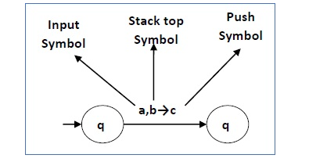

Slide 11
Characteristic of PDA
Given (q_{j}, B)∈ δ(q_{i}, a, A): means that the PDA when in state q_{i}, reads symbol a, and having symbol A on top of the stack, is allowed to do the following: -
Read a
POP A
PUSH B
Change to state q_{j}

Slide 12
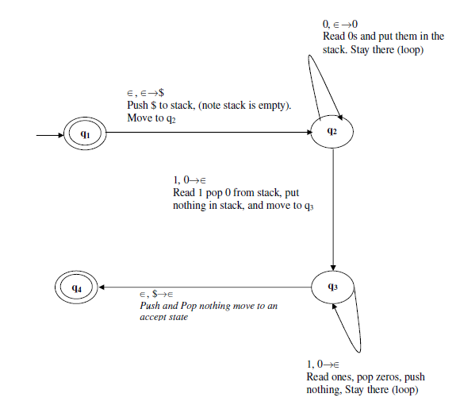
Consider the PDA machine that recognizes the language {0^{n},1^{n} l n≥0}, We design the following state diagram for the PDA.

Slide 13
NB: $ is a symbol / Mechanism to help us know that the stack is empty. Now, from the above characteristic of PDA, we can conclude that: -
(q₂, 0)∈ δ(q₂, 0, ∈)
(q₂, $)∈ δ(q₁, ∈, ∈)
etc.

Slide 14
The following is the formal description of this PDA that recognizes the language {0^{n},1^{n} l n≥0},
Let M₁ be (Q, ∑, Г, δ , q₀, F);
Where;
Q ={ q_{1,} q_{2,} q_{3,} q₄},
∑ = {0,1, ∈}
Г = {0, $, ∈}
δ: Q X ∑∈ X Г ∈ →P (Q X Г ∈) is the transition function given by the table in the next slide: -
q₀ ∈ Q = q₁ is the start state, and
F⊆ Q = {q₁, q₄}

Slide 15
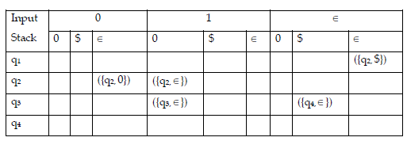
recall
(q₂, 0)∈ δ(q₂, 0, ∈)
(q₂, $)∈ δ(q₁, ∈, ∈)
etc.

Slide 16
Turing Machine (TM )next……

Slide 17
Questions????
Comments
Question Two
Indicate the set of steps followed by the PDA upon reading string 000111
Question Three:
Identify the error in the PDA transition table (slide 14).

